Slide 1


SUPPORTIVE PERIODONTAL THERAPY
RUNGTA COLLEGE OF DENTAL SCIENCES AND RESEARCH,BHILAI
PRESENTED BY:
Dr Sonika Bodhi
Reader
Dept. of Periodontology

Slide 2
SPECIFIC LEARNING OBJECTIVES
Core areas | Domain | Category
Introduction | Affective | Desire to know
Definition | Cognitive | Nice to know
Therapeutic objectives | Cognitive | Nice to know
SPT for gingivitis | Cognitive | Must to know
SPT for periodontitis | Cognitive | Must to know
Maintenance program | Cognitive | Must to know
Classification of post treatment patients | Cognitive | Must to know
Maintainence care for patients with dental implants | Cognitive | Nice to know

Slide 3
Contents
Introduction
Definition
Therapeutic objectives
SPT for gingivitis
SPT for periodontitis
Maintenance program
Classification Of Post Treatment Patients
Maintainence care for patients with dental implants
Summary
References

Slide 4
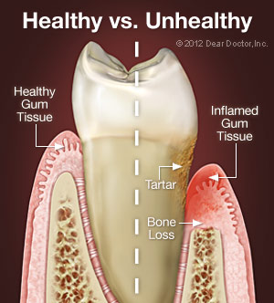
INTRODUCTION
Chronic periodontitis is an infectious disease
caused by an opportunistic microflora.
The infection triggers host inflammatory
responses resulting in the destruction of the tooth supporting tissues.
Untreated chronic periodontitis has been described
as a slowly progressive disease affecting
individual teeth or tooth sites, showing evidence of
periods of stability and periods of progression.

Slide 5
The maintenance phase of periodontal treatment starts immediately after the completion of Phase I therapy.
While the patient is in the maintenance phase, the necessary surgical and restorative procedures are performed.
This ensures that all areas of the mouth retain the degree of health attained after Phase I therapy.

Slide 6
INCORRECT SEQUENCE
Phase-I
Phase III (Restorative)
PhaseIV (Maintenance)
Revaluation
Phase II -periodontal surgery

Slide 7
CORRECT SEQUENCE
PHASE-I
REEVALUATION
PHASE IV (Maintenance)
Phase III (Restorative)
Phase II(periodontal surgery)

Slide 8
DEFINITION
Procedures performed at selected intervals to assist the periodontal patient in maintaining oral health.
As part of periodontal therapy, an interval is established for periodic ongoing care.
…..Glossary of periodontal Terms
Supportive periodontal treatment is the phase of periodontal therapy during which periodontal diseases& conditions are monitored and etiological factors reduced or eliminated.

Slide 9
AIMS & OBJECTIVES
The aim of this treatment is the prevention of reinfection & disease recurrence.
For each individual patient a recall system must be designed that includes
(1) assessment of deepened sites with bleeding on
probing,
(2) instrumentation of such sites,
(3)fluoride application for the prevention of dental
caries.

Slide 10
THERAPEUTIC OBJECTIVES
To Prevent The Progression & Recurrence Of Periodontal Disease In Patients Who Have Previously
Been Treated For Gingivitis & Periodontitis.
To Prevent The Loss Of Dental Implants After Clinical Stability Has Been Achieved.

Slide 11
THERAPEUTIC OBJECTIVES
To Reduce Tooth Loss By Monitoring The Dentition
& Any Prosthetic Replacements Of The Natural Teeth.
To Diagnose &Manage, In A Timely Manner,
Other Diseases Or Conditions Found Within Or Related To The Oral Cavity.

Slide 12
Supportive Periodontal Therapy for patients with gingivitis
Adults whose effective oral hygiene is combined with periodic professional prophylaxis are healthier periodontally than patients who do not participate in SPT programs (Lövdal et al. 1961;Suomi et al. 1971).
One particular study of historical significance was performed on 1428 adults from an industrial company in Oslo, Norway (Lövdal et al.1961).

Slide 13
Over a 5-year observation period, the subjects were recalled two to four times per year for instruction in oral hygiene and supragingival and subgingival scaling.
Gingival conditions improved by approximately 60% and tooth loss was reduced by about 50% of what would be expected without these efforts.

Slide 14
The prevention of gingival inflammation and early loss of attachment in patients with gingivitis depends on
  the level of personal plaque control,
  further measures to reduce the accumulation of supragingival and subgingival plaque.

Slide 15
Supportive Periodontal Therapy for patients with PERIODONTITIS
SPT is an absolute prerequisite to guarantee beneficial treatment outcomes with maintained levels of clinical attachment over long periods of time.
The maintenance of treatment results for the majority of patients has been documented up to 14 years, and in a private practice situation even up to 30 years.

Slide 16
a small proportion of patients will experience recurrent infections with progression of periodontal lesions in a few sites in a completely unpredictable mode.
The continuous risk assessment at
subject,
tooth and
tooth site levels, therefore, represents a challenge for the SPT concept.

Slide 17
MAINTENANCE PROGRAM
Periodic recall visits form the foundation of a meaningful long-term prevention program.
The interval between visits is initially set at 3 months but may be varied according to the patient’s needs.
Periodontal care at each recall visit comprises of the following parts.

Slide 18
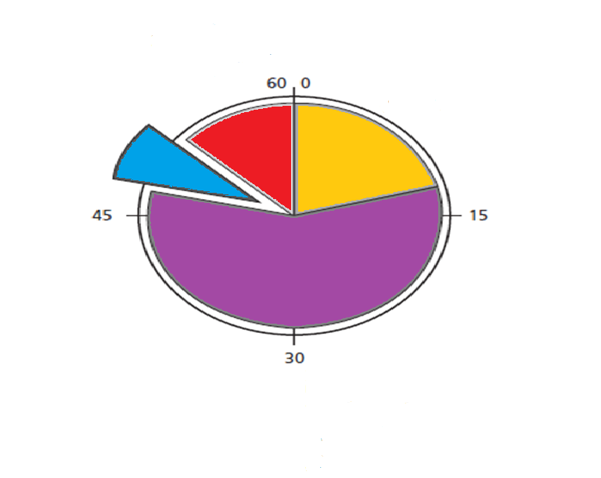
SPT RECALL HOUR
Polishing
Fluorides
Determination of future SPT
(8 minutes)
Treatment of re-infected sites
Examination
Reevaluation
Diagnosis
(10-15 min)
Motivation
Reinstruction
(5-7 minutes)
Instrumentation
Scaling & root planing
(30-40 minutes)

Slide 19
Maintenance procedures include
An Update Of The Medical & Dental History
Radiographic Review,
Extra oral & Intraoral Soft Tissue Examination
Dental Examination & Periodontal Evaluation
Removal Of The Bacterial Flora From Crevicular & Pocket Areas,
Scaling & Root Planing Where Indicated
Polishing Of The Teeth, & A Review Of The Patient's Plaque Control Efficacy.

Slide 20
SPT RECALL HOUR
Part I: Examination
(Approximate time: 14 minutes)
Patient greeting
Medical history changes
Oral pathologic examination
Oral hygiene status
Gingival changes Reevaluation
Pocket depth changes
Mobility changes
Occlusal changes
Dental caries
Restorative, prosthetic, and implant status

Slide 21
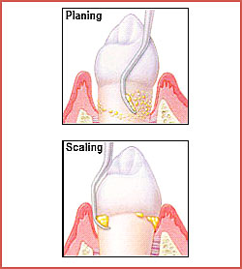
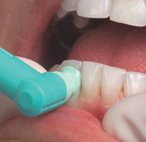
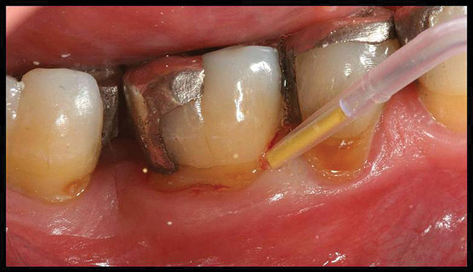
SPT RECALL HOUR
Part II: Treatment
(Approximate time: 36 minutes)
Oral hygiene reinforcement
Scaling
Polishing
Chemical irrigation or site-specific antimicrobial placement

Slide 22
SPT RECALL HOUR
Part III: Report, Cleanup, and Scheduling
(Approximate time: 10 minutes)
Write report in chart.
Discuss report with patient.
Clean and disinfect operatory.
Schedule next recall visit.
Schedule further periodontal treatment.
Schedule or refer for restorative or prosthetic treatment.

Slide 23
Radiographic evaluation of periodontal disease progression
Radiographs should be current and should be based on the diagnostic needs of the patient and should permit proper evaluation and interpretation of the status of the periodontium.
Radiographs of diagnostic quality are necessary for these purposes,the judgement of the clinician, as well as the degree of disease activity.
Radiographic abnormalities should be noted.

Slide 24
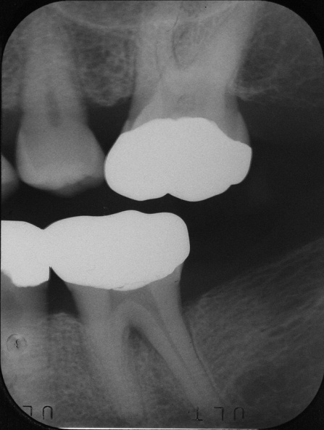
Radiographic evaluation of periodontal disease progression
Depending on the initial severity of the case and the findings at the recall visit ,These are compared with findings on previous radiographs to check the bone height and look for repair of osseous defects, signs of trauma from occlusion,
periapical pathologic changes,
caries.

Slide 25
Radiographic Examination of Recall Patients for Supportive Periodontal Treatment
Patient Condition/Situation | Type of Examination
Clinical caries or high-risk factors for caries. | Posterior bite-wing examination at 12- to 18-month intervals.
Clinical caries and no high-risk factors for caries. | Posterior bite-wing examination at 24- to 36-month intervals.
Periodontal disease not under good control. | Periapical and/or vertical bite-wing radiographs of problem areas every 12 to 24 months; full-mouth series every 3 to 5 years.

Slide 26

Radiographic Examination of Recall Patients for Supportive Periodontal Treatment
Patient Condition/Situation | Type of Examination
History of periodontal treatment with disease under good control. | Bite-wing examination every 24 to 36 months; full-mouth series every 5years
Root form dental implants. | Periapical or vertical bite-wing radiographs at 6, 12, and 36 months after prosthetic placement, then every 36 months unless clinical problems arise.
Transfer of periodontal or implant maintenance patients. | Full-mouth series if a current set is not available. If full-mouth series has been taken within 24 months, radiographs of implants and periodontal problem areas should be taken.

Slide 27
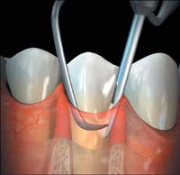
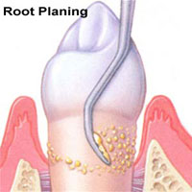
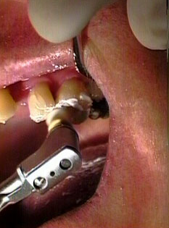
TREATMENT
The required scaling and root planing are performed, followed by an oral prophylaxis .

Slide 28
TREATMENT
Care must be taken not to instrument normal sites with shallow sulci (1-3 mm deep), because studies have shown that repeated subgingival scaling and root planing in initially normal periodontal sites result in significant loss of attachment.
….Lindhe J et al 1982
Irrigation with antimicrobial agents or placement of site-specific antimicrobial devices is performed in maintenance patients with remaining pockets.

Slide 29
RECURRENCE OF PERIODONTAL DISEASES
Inadequate plaque control on the part of the patient or failure to comply with recommended SPT schedules.
The decision to re-treat a periodontal patient should not be made at the preventive maintenance appointment but should be postponed for 1 to 2 weeks. Often the mouth looks much better at that time because of the resolution of edema and the resulting improved tone of the gingiva.

Slide 30
CLASSIFICATION OF POST TREATMENT PATIENTS
Recall Intervals for Various Classes of Recall Patients
Merin Classification | Characteristics | Recall Interval
First year | First-year patient: routine therapy and uneventful healing. First-year patient: difficult case with complicated prosthesis, furcation involvement, poor crown-to-root ratios, or questionable patient cooperation. | 3 months 1-2 months

Slide 31
Recall Intervals for Various Classes of Recall Patients
Merin Classification | Characteristics | Recall Interval
Class A | Excellent results well maintained for 1 year or more. Patient displays good oral hygiene, minimal calculus, no occlusal problems, no complicated prostheses, no remaining pockets, and no teeth with less than 50% of alveolar bone remaining. | 6 months to 1 year

Slide 32
Recall Intervals for Various Classes of Recall Patients
Merin Classification | Characteristics | Recall Interval
Class B | Generally good results maintained reasonably well for 1 year or more, but patient displays some of the following factors: 1. Inconsistent or poor oral hygiene 2. Heavy calculus formation 3. Systemic disease that predisposes to periodontal breakdown 4. Some remaining pockets 5. Occlusal problems 6. Complicated prostheses 7. Ongoing orthodontic therapy 8. Recurrent dental caries 9. Some teeth with less than 50% of alveolar bone support 10. Smoking 11. Positive family history or genetic test 12. More than 20% of pockets bleed on probing | 3-4 months (decide on recall interval based on number and severity of negative factors)

Slide 33
Recall Intervals for Various Classes of Recall Patients
Class C | Generally poor results after periodontal therapy and/or several negative factors from the following list: 1. Inconsistent or poor oral hygiene 2. Heavy calculus formation 3. Systemic disease that predisposes to periodontal breakdown 4. Many remaining pockets 5. Occlusal problems 6. Complicated prostheses 7. Recurrent dental caries 8. Periodontal surgery indicated but not performed for medical,psychologic, or financial reasons 9. Many teeth with less than % of alveolar bone support 10. Condition too far advanced to be improved by periodontal surgery 11. Smoking 12. Positive family history or genetic test 13. More than 20% of pockets bleed on probing | 1-3 months (decide on recall interval based on number and severity of negative factors; consider re-treating some areas or extracting severely involved teeth)

Slide 34
REFERRAL OF PATIENTS TO THE PERIODONTIST
Class A recall patients should be maintained by the general dentist, whereas class C patients should be maintained by the specialist .
Class B patients can alternate recall visits between the general practitioner and the specialist .
The suggested rule is that the patient's disease should dictate whether the general practitioner or the specialist should perform the maintenance therapy.

Slide 35
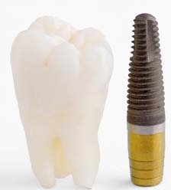
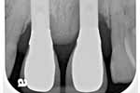
MAINTAINENCE CARE FOR PATIENTS WITH DENTAL IMPLANTS
Patients with implants are susceptible to a form of bone loss called periimplantitis, and evidence suggests that such patients may be more prone to plaque-induced inflammation with bone loss than those with natural teeth.
…..Bauman GR et al 1992
Notes:
4-19%o pt

Slide 36
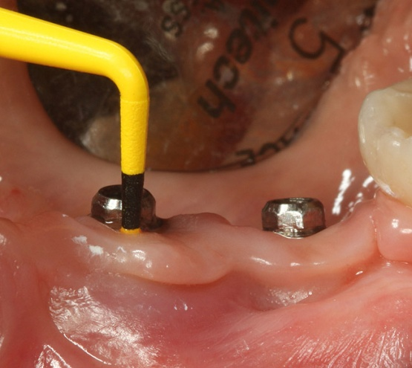
periimplantitis, difficult to treat, it is extremely important to treat periodontal disease before implant placement and to provide good supportive therapy with implant patients.
Grunder U et al 1993
Special instrumentation that will not scratch the implants are used for calculus removal on the implants.
Acidic fluoride prophylactic agents are avoided
Nonabrasive prophy pastes are used.
Notes:
4-19%o pt

Slide 37
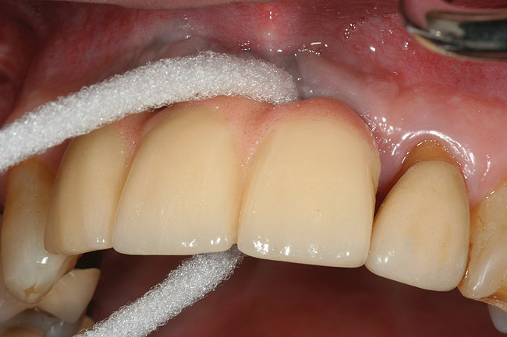
During the phase after uncovering the implants, patients must use ultrasoft brushes, chemotherapeutic rinses, tartar control pastes, irrigation devices, and yarnlike materials to keep the implants and natural teeth clean.
Notes:
4-19%o pt

Slide 38
SUMMARY
Periodic recall visits form the foundation of a meaningful long term prevention program. “Prevention is better than cure”

Slide 39
REFREENCES
Newman MG, Takei HH, Klokkevold PR, Carranza FA. Carranza’s clinical periodontology, 10th ed. Saunders Elsevier; 2007.
Lindhe J, Lang NP and Karring T. Clinical Periodontology and Implant Dentistry. 6th ed. Oxford (UK): Blackwell Publishing Ltd.; 2015.
Newman MG, Takei HH, Klokkevold PR, Carranza FA. Carranza’s clinical periodontology, 13th ed. Saunders Elsevier; 2018.

